Slide 1
2019 MMILAB.DIP Seminar Week6(2/17~2/25)
20151415 김성수

Slide 2
Contents
Optical Flow
- Assumption and Aperture problem
Lucas-Kanade Algorithm
Kalman Filter
Theory
Implement consideration
Implement result

Slide 3
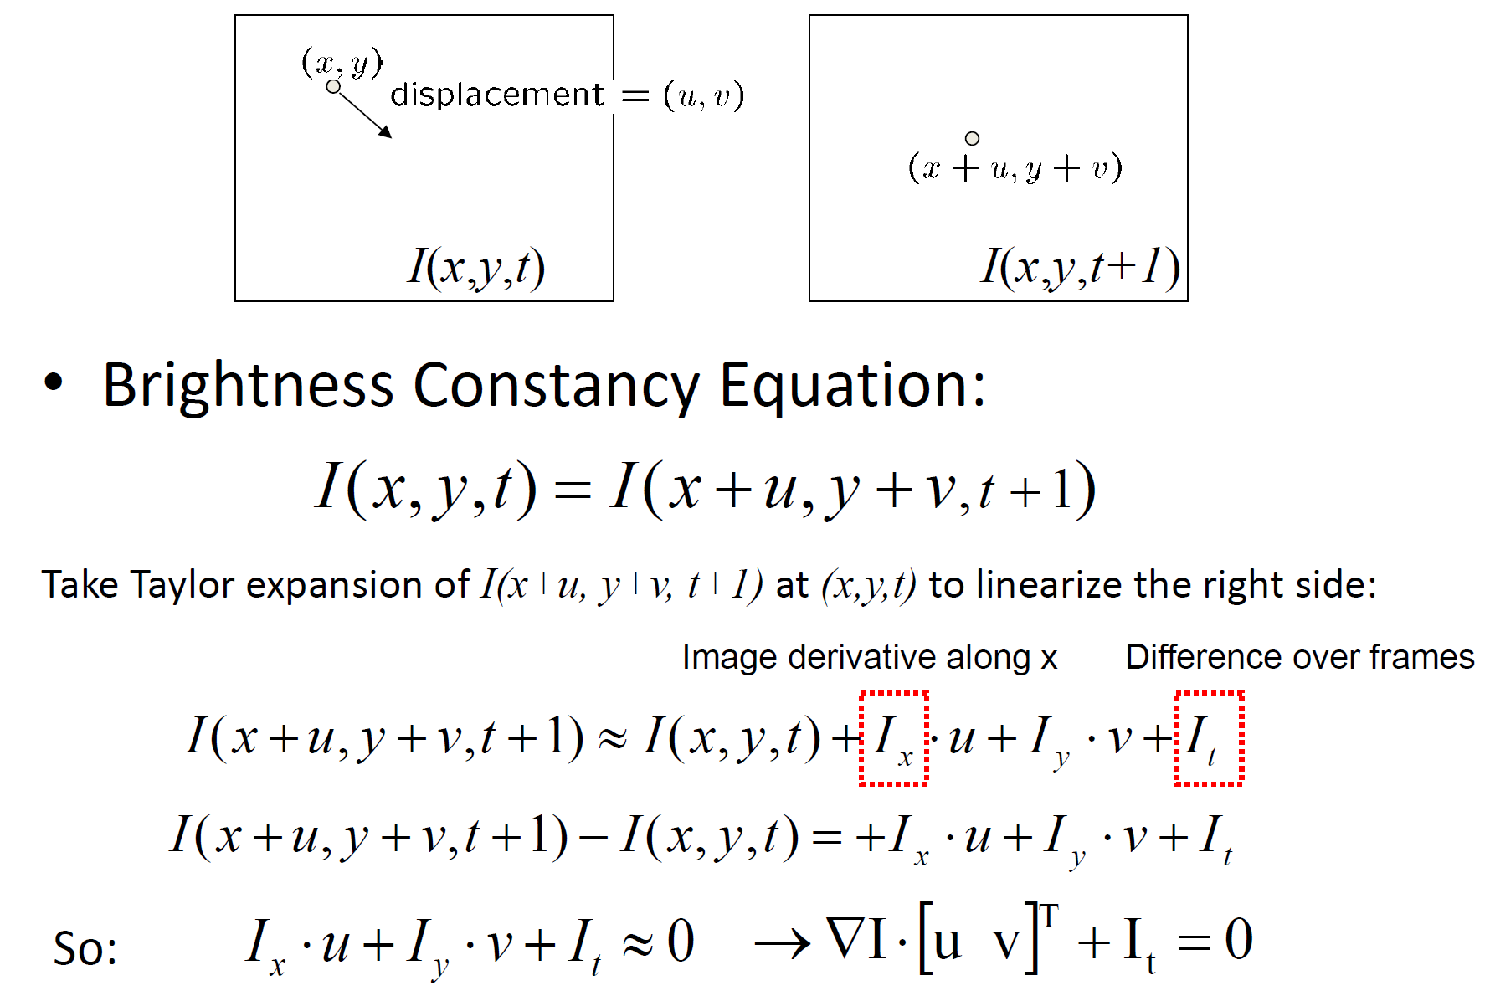
Optical flow – Brightness constancy assumption
Optical flow is defined as the apparent motion of individual pixels on the image plane

Slide 4
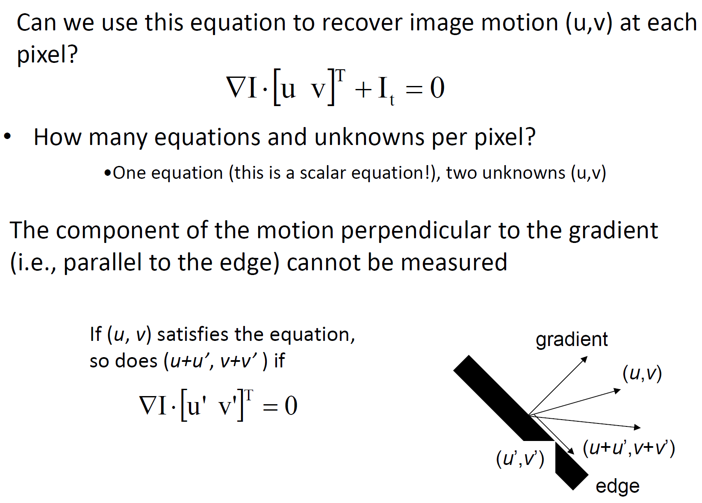
Optical flow – Brightness constancy assumption
Aperture Problem

Slide 5
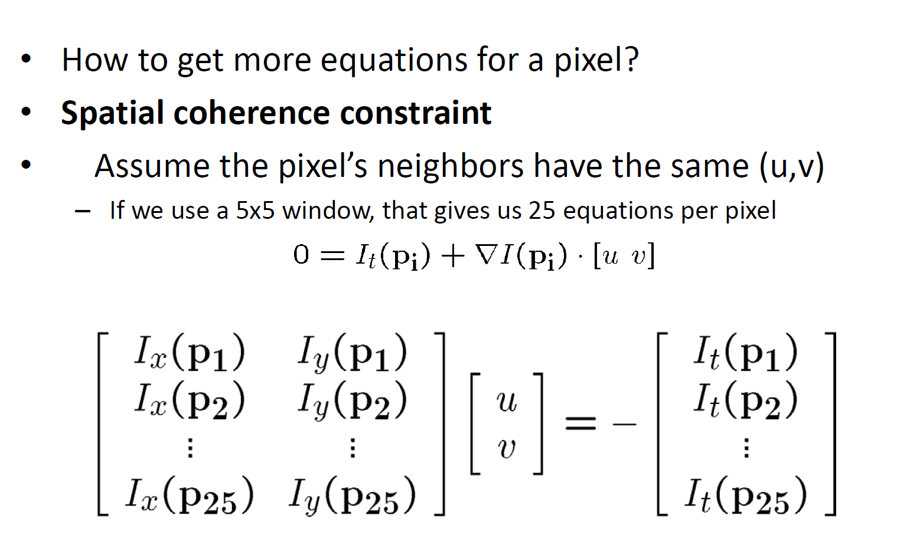
Optical flow – Lucas Kanade algorithm

Slide 6
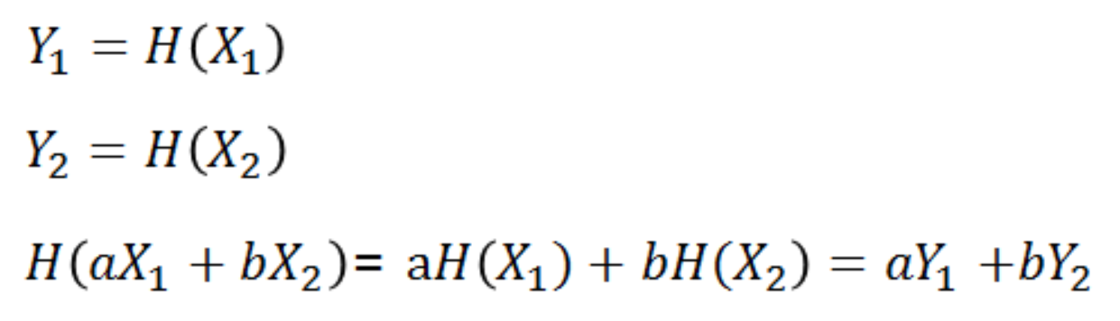
Kalman filter - overview
Mathematically, Kalman filer is an estimator that predicts and corrects the states of wide range of linear processes
(for nonlinear process -> Extended Kalman filter)
Linear process =
Process which have linear relation between current and previous state
Newton’s equation about motion(velocity, acceleration..) are all linear
Linear system can be computed by matrix

Slide 7
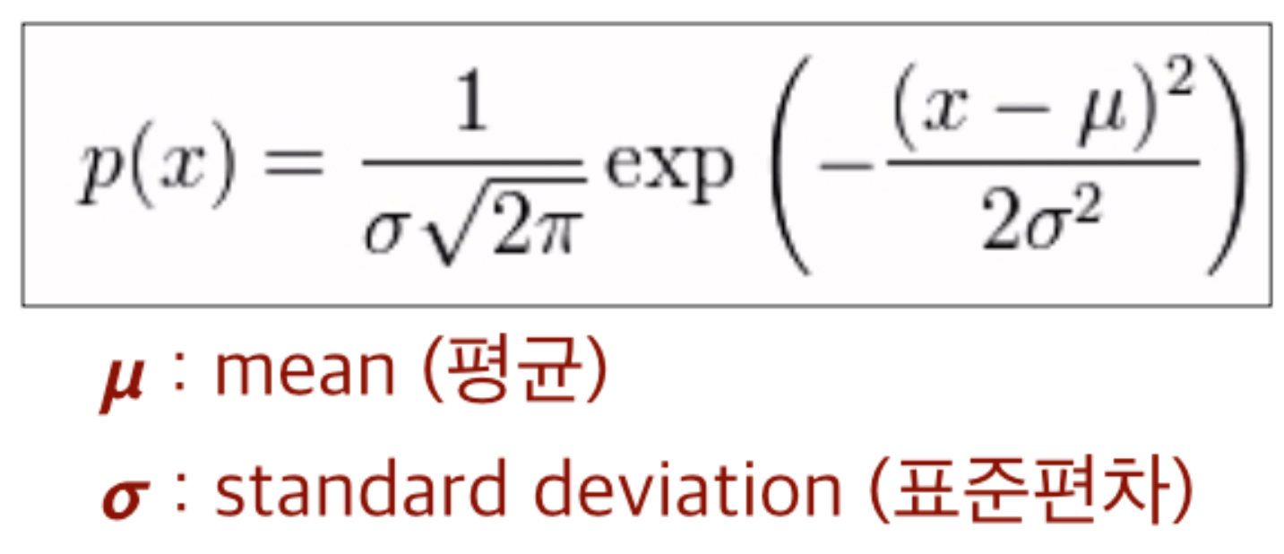
Kalman filter - Overview
1.과거의 정보와 새로운 측정값을 사용하여 측정값에 포함된 잡음을 제거시켜 최적의 값을 추정하는데 사용하는 알고리즘.
2. 선형적(linear) 움직임을 갖는 대상에 재귀적(recursive)으로 동작
(자연계의 움직임의 어느정도 예측가능하고 일반적 움직임 물성을 갖기 때문에)
3.잡음은 시간에 영향이 없는 백색잡음(white noise)이고 Gaussian 정규분포를 따라야 함.
-> 평균과 분산 으로 정확히 모델링이 가능하기 때문.
4.재귀적 자료 처리 방식은 과거 데이터의 평균을 알기 위해서 과거의 모든 데이터를 저장하고 갱신할때 마다 모두 계산하는 것이 아닌 과거값과 현재값만 기억하여 전체 평균을 알기 위해 사용.
Ex_ K번째 입력을 Vk, k번째 입력까지의 평균값을 Y(k)라고 할 때
Y(k) = Y(k-1)*((k-1)/k) + (1/k)*Vk

Slide 8
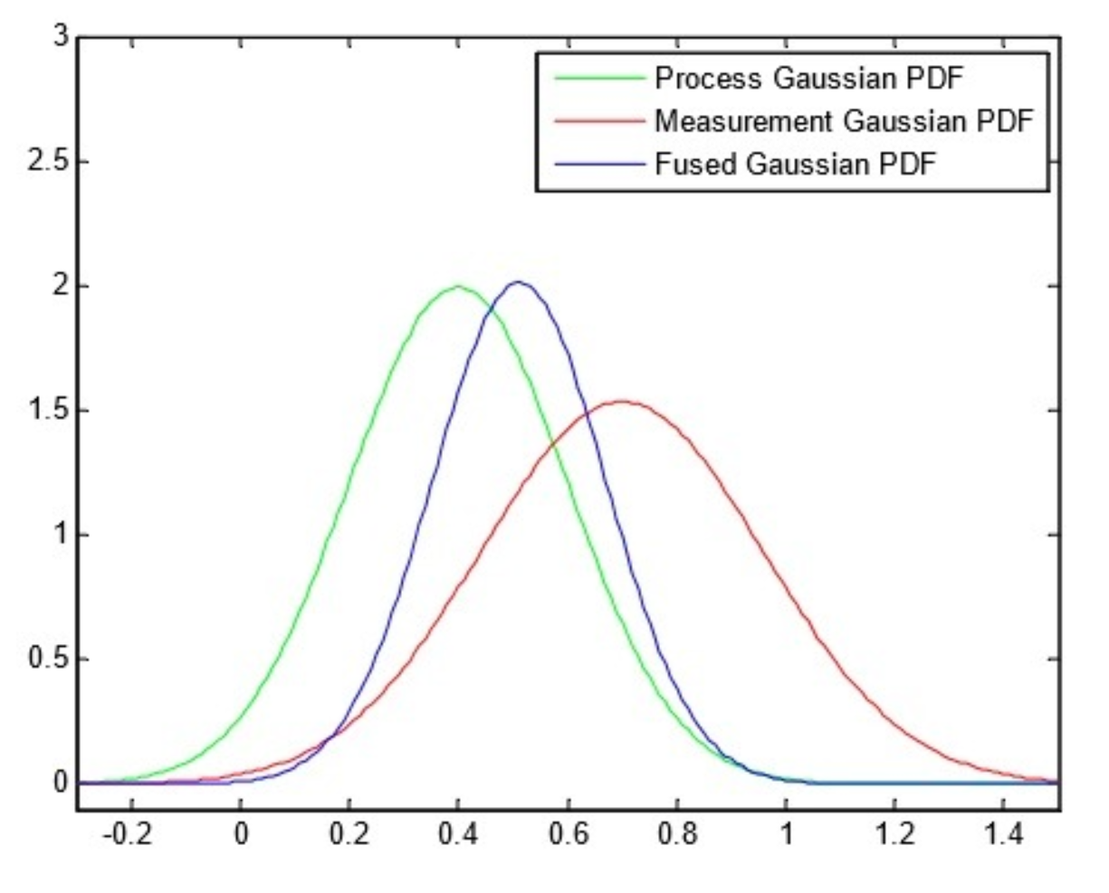
Kalman filter - Overview
5. 입력된 2개의 데이터 V1, V2의 평균은 (V1+V2)/2이나 이 경우 두 데이터의 중요도가 같음.
그러나 한 데이터가 잡음에 가까워 튀었다면 평균을 계산 할 때 가중치가 달라져야 함.
6 .평균에서 얼마나 벗어났는가를 나타내는 지표는 표준편차이고 각 데이터의 중요도는 표준편차의
제곱(분산)에 반비례함. 따라서 표준편차가 클수록 그 값의 중요도는 떨어지고 평균에 대한 기여도 또한 작아져야 함.
7.이처럼 연속적인 이전의 출력값과 새로운 입력값의 중요도를 감안하여 2개의 데이터로 평균을 구하고 새로운 최적값을 계산하는 측정 갱신 알고리즘이 바로 칼만 필터 이며 일반적으로 행렬 혹은 벡터로 나타냄.

Slide 9

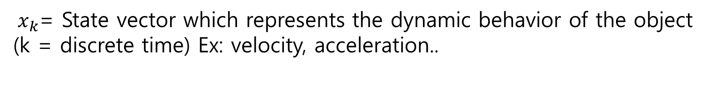
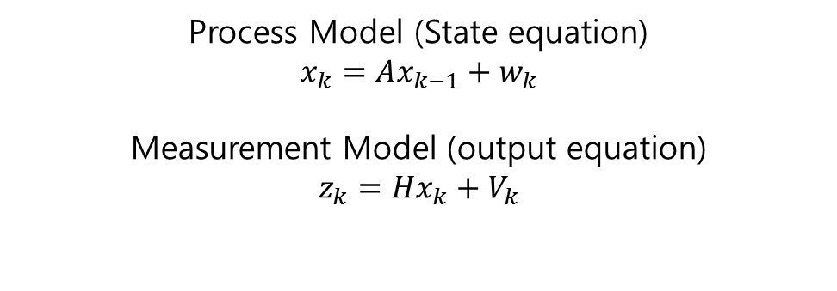
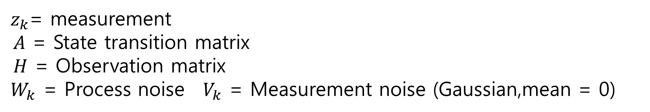
Kalman filter – Tracking System
Objective=Estimating${ x}_{k}$ from $z_{k}$
Process Model (State equation)
$$x_{k}=Ax_{k−1}+w_{k}$$
Measurement Model (output equation)
$$z_{k}=Hx_{k}+V_{k}$$
${ x}_{k}$= State vector which represents the dynamic behavior of the object
(k = discrete time) Ex: velocity, acceleration..
${ z}_{k}$= measurement
$A$ = State transition matrix
$H$ = Observation matrix
${ W}_{k}$ = Process noise ${ V}_{k}$ = Measurement noise (Gaussian,mean = 0)

Slide 10
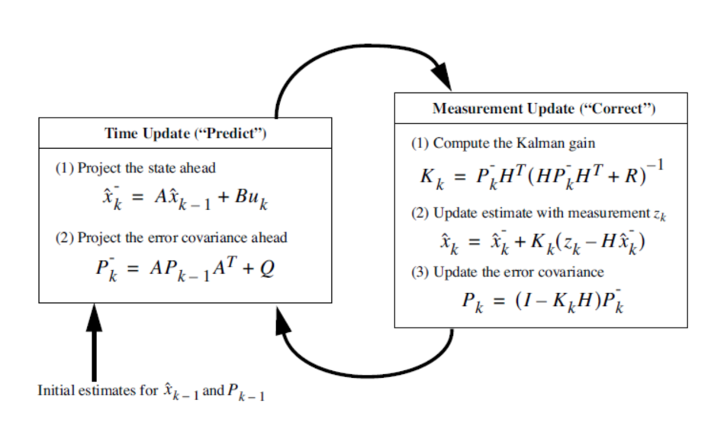
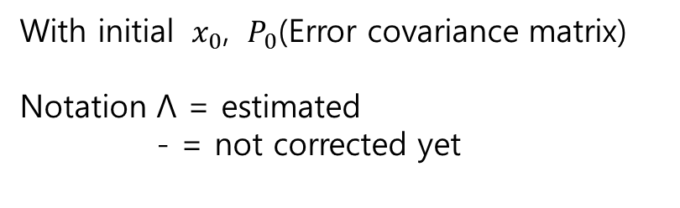
Kalman filter
With initial ${ x}_{0}$, ${ P}_{0}$(Error covariance matrix)
Notation Λ = estimated
- = not corrected yet
R = measurement noise
System noise

Slide 11
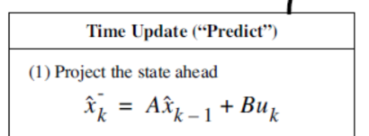
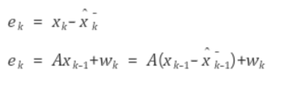
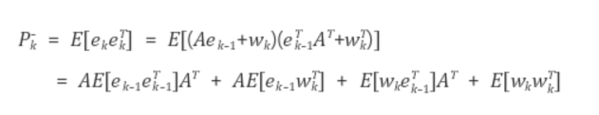
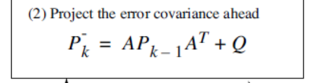


Kalman filter – Step by Step(Time update)
1. $Predict{ x}_{k} by{ \hat{x}}_{k}$ = $A{ \hat{x}}_{k−1}$
Estimation error
2. Predict P(Error covariance)
Zero correlation (∵ white noise)

Slide 12
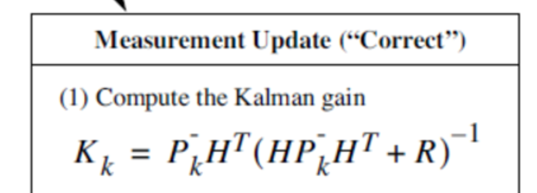
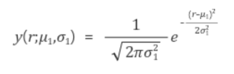

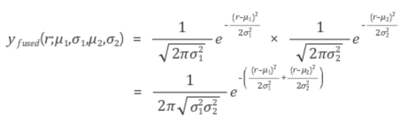
Kalman filter – Step by Step(Measurement update)
3. Get Kalman gain
Joint PDF
X
=

Slide 13
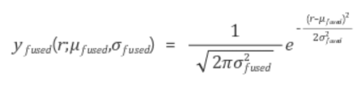
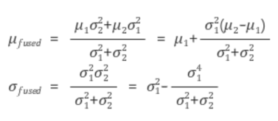
Kalman filter - Step by Step(Measurement update)
But we need scaling, because domain(unit) of each noise PDF is different

Slide 14
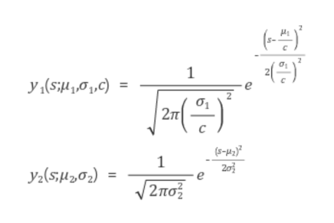
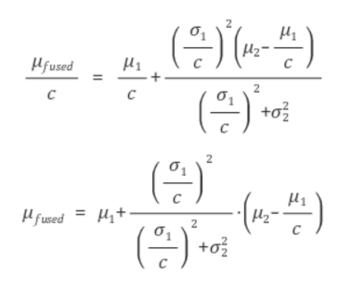



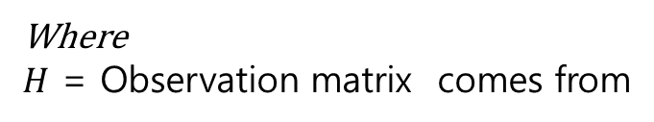
Kalman filter - Step by Step(Measurement update)
Do this again
If we choose and
If R gets bigger,
gain gets smaller
Where
$H$ = Observation matrix comes from

Slide 15
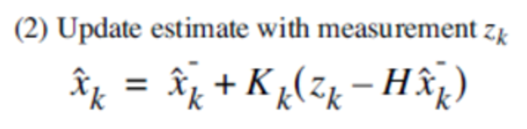

Kalman filter - Step by Step(Measurement update)
If H = I(identity matrix)
K = 1 means we can surely use measurement value
K = 0 means we can’t use measurement value, but predict value

Slide 16
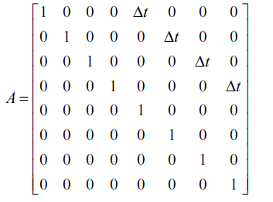
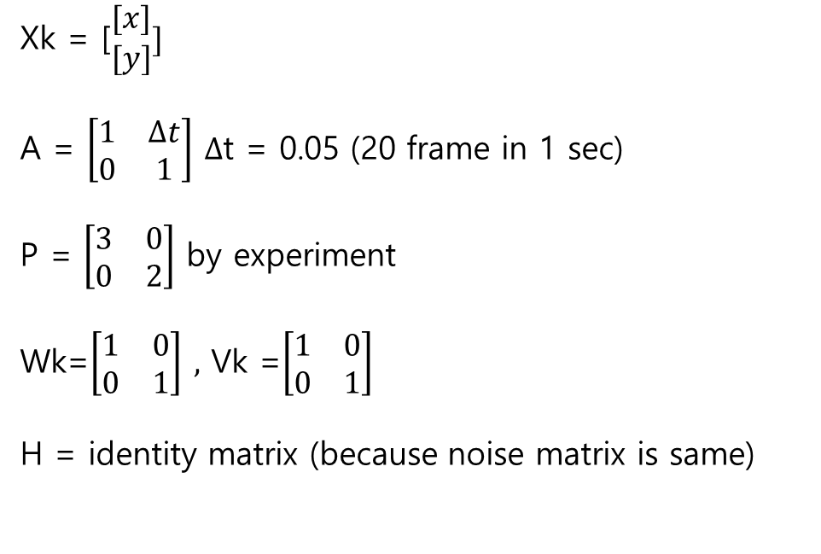
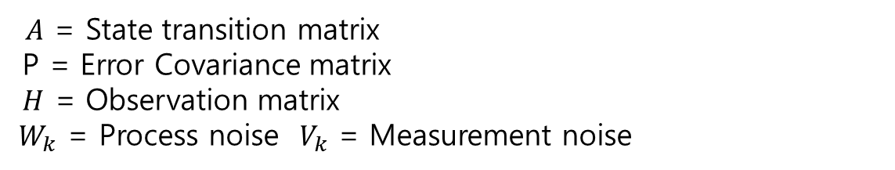
Kalman filter – Implement consideration
1. How can we decide matrix in image object tracking?
$A$ = State transition matrix
P = Error Covariance matrix
$H$ = Observation matrix
${ W}_{k}$ = Process noise $V_{k}$ = Measurement noise
Xk = [$\begin{matrix}[x] \\ [y]\end{matrix}]$
A = $\left[\begin{matrix}1 & ∆t \\ 0 & 1\end{matrix}\right]$ $∆$t = 0.05 (20 frame in 1 sec)
P = $\left[\begin{matrix}3 & 0 \\ 0 & 2\end{matrix}\right]$ by experiment
Wk=$\left[\begin{matrix}1 & 0 \\ 0 & 1\end{matrix}\right] ,$ Vk =$\left[\begin{matrix}1 & 0 \\ 0 & 1\end{matrix}\right]$
H = identity matrix (because noise matrix is same)

Slide 17
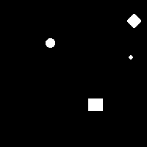
Kalman filter – Implement consideration
2. How can we get center pixel of object for each frame?
Solution1 (Only for threshold image)
: First, Threshold the image
Second, Label each object of the image.(two-pass)
Third, for every pixels of each labeled number, compute mean value of x,y value
Solution2 (General purpose)
: First, threshold the image.
Second, get edge of the image using edge detector
Third, get circumscribed circle of each edges
Fourth, get centeroid of each circle

Slide 18
Kalman filter – Implement consideration
3. How can we match each centeroid value of object to predicted value?
->Use Hungarian Algorithm
Hungarian Algorithm?
Algorithm used to resolve assignment problem for minimum cost summation
By using this ,we can get pairs which have minimum distance (between centroid and prediction point) summation

Slide 19
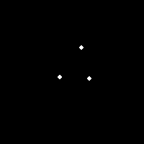
Kalman filter – Implement consideration
3. How can we match each centeroid value of object to predicted value?
->Use Hungarian Algorithm
Distance = | centroid of object 1 | centroid of object 2 | centroid of object 3
predicted value(object1) | 3 | 8 | 16
predicted value(object2) | 7 | 1 | 13
predicted value(object3) | 14 | 11 | 4
1
2
3
Find minimum distance summation pair = high possibility of correct matching (with no overlap)

Slide 20
Kalman filter – Implement consideration
Hungarian Algorithm: summation or substraction over each component doesn’t change optimal solution
6 | 4 | 1 | 5
10 | 6 | 3 | 8
7 | 6 | 4 | 5
9 | 10 | 3 | 8
5 | 3 | 0 | 4
7 | 3 | 0 | 5
3 | 2 | 0 | 1
6 | 7 | 0 | 5
2 | 1 | 0 | 3
4 | 1 | 0 | 4
0 | 0 | 0 | 0
3 | 5 | 0 | 4
-min(row)
-min(col)
1 | 0 | 0 | 2
3 | 0 | 0 | 3
0 | 0 | 1 | 0
2 | 4 | 0 | 3
1 | 0 | 0 | 2
3 | 0 | 0 | 3
0 | 0 | 1 | 0
2 | 4 | 0 | 3
0 | 0 | 0 | 1
2 | 0 | 0 | 2
0 | 1 | 2 | 0
1 | 4 | 0 | 2
minimum cost : 6+6+5+3 = 20

Slide 21
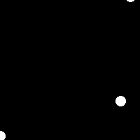
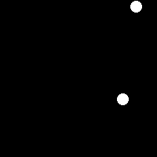
Kalman filter – Implement consideration
4. What if object disappear ? (for 1~3 frames) Or what if objects merge together?
Predicted 3, but 2 object
Distance = | centroid of object 1 | centroid of object 2
predicted value(object1) | 3 | 8
predicted value(object2) | 7 | 1
predicted value(object3) | 3 | 4
Doesn’t matter
in algorithm
Frame 18
Frame 19
-> Just leave predicted value for few frames (wait until object appears again near last position)
-> If no object appears in few frames, delete the value.
-> But if other object comes near the last position in few frames, tracking object changes
For furthermore problem, set distance threshold for correct matching.

Slide 22
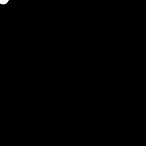

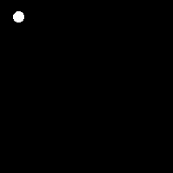
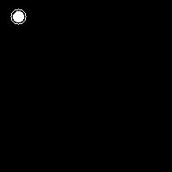
Kalman filter – Implement result
Sequence 1
Tracking
Speed x 0.25
Sequence 2
Tracking
Speed x 0.25

Slide 23
Kalman filter – Implement result
Disappear ,merge problem
Sequence 1
No wait
Wait for 3frame
Wait for 8frame
Sequence 2
No wait
Wait for 3frame
Wait for 8frame

Slide 24
THANK YOU for your attention

